Slide 1
Low latency Java
systems
Stefan Angelov

Slide 2



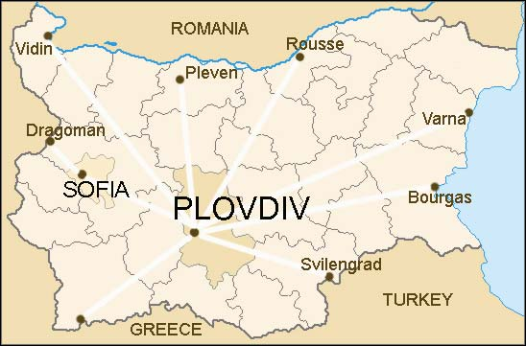

Architect Lead at
Co-Founder and Trainer at
Stefan Angelov
The Java guy from pLoVEdiv
You can find me here:

Slide 3
Agenda
What is low latency systems?
How JVM works (Phases & Metaspace)
Java’s Memory Model — Heap, Stack, and Metaspace
Heap Memory Best Practices
Thread Synchronization
LMAX disruptor
Chronicle Map
Chronicle Queue

Slide 4
Is Java a good choice for low latency programing ?

Slide 5

What is low latency systems?
Low latency systems are computer systems or networks engineered to minimize the time it takes to process and transmit data.
They are optimized for speed, aiming to achieve the lowest possible delay or latency in performing tasks.

Slide 6
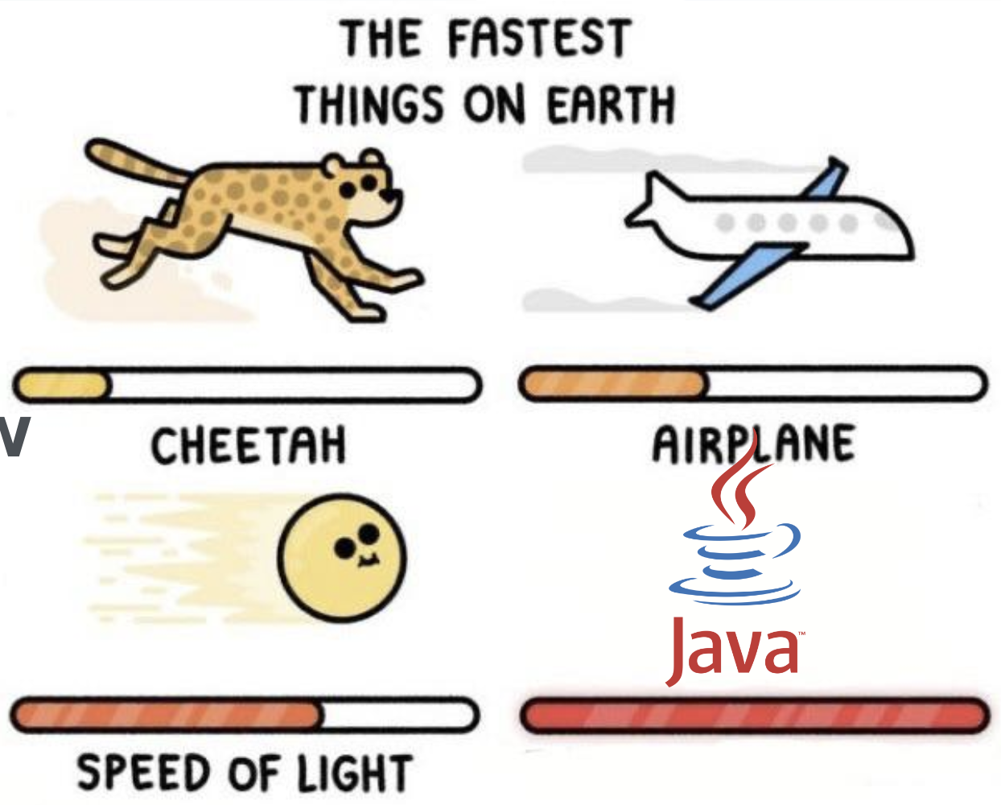
Introduction - Timescales
1 / 1 000 s = millisecond (ms)
1 / 1 000 000 s = microsecond (us)
1 / 1 000 000 000 s = nanosecond (ns)

Slide 7
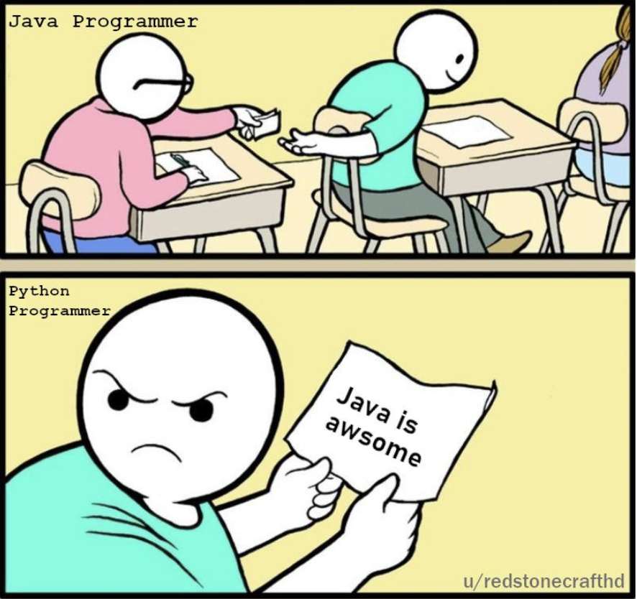
Language comparison
Java - aim for 10 us (microsecond)
C/C++ aim for 10 us (microsecond)
Python is around 50 times slower than Java

Slide 8

Low latency domains
High frequency trading
Online gaming
Betting and bidding
Vehicle autopilot systems

Slide 9
Throughput, Batching, and Response Time

Slide 10
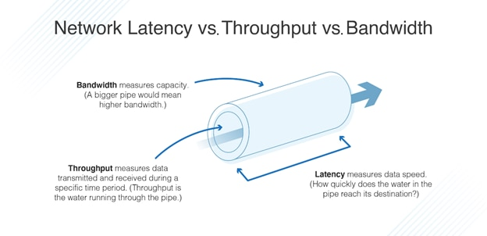
Throughput Measurements
A throughput measurement is based on the amount of work that can be accomplished in a certain period of time
Transactions per second (TPS)
Requests per second (RPS)
Operations per second (OPS)

Slide 11
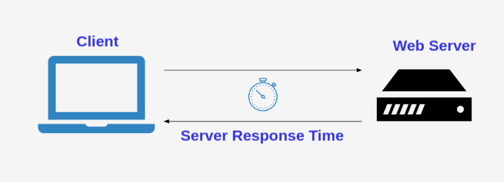
Response-Time
Response time refers to the interval between the initiation of a request and the completion of the response.

Slide 12
Why Java not some other language ?

Slide 13



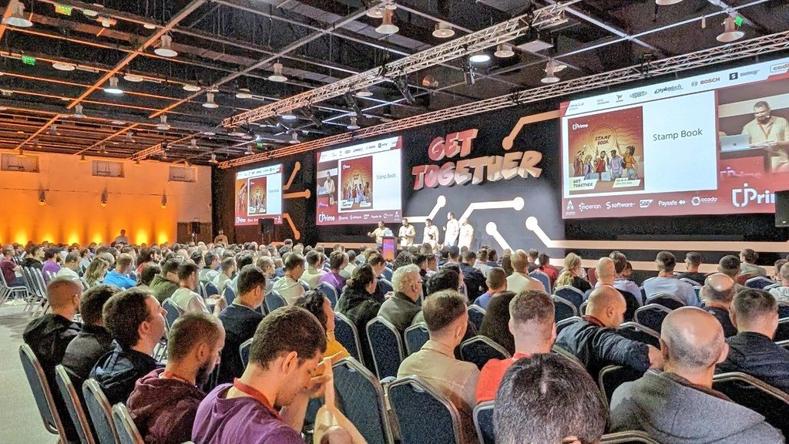
Wide ecosystems
Amazing Community
Speed of development
More smooth hiring
Speed of code

Slide 14
What are the challenges of using Java for low latency?

Slide 15
Challenges of using Java
Let's try to understand how to mitigate some of those challenges…
Garbage collection
Warmup
Unpredictable compilation
Don't have control of the memory layout
Unsafe

Slide 16
How JVM works (Phases & Metaspace)

Slide 17
Just-in-Time Compilers: An Overview
Java applications are compiled,but instead of being compiled into a specific binary for a specific CPU, they are compiled into an intermediate low-level language. This language (known as Java bytecode) is then run by the java binary.
profiling
profiling
Interpreter
C1
C2
Generate code
quickly
Generate highly optimized code
Interpreter and profile
Save compiled
code
Save compiled
code
code cache
Deoptimization
Deoptimize compiled code

Slide 18
Are there any problems here?
string concatenation
getNumberOfParticipants invocations

Slide 19
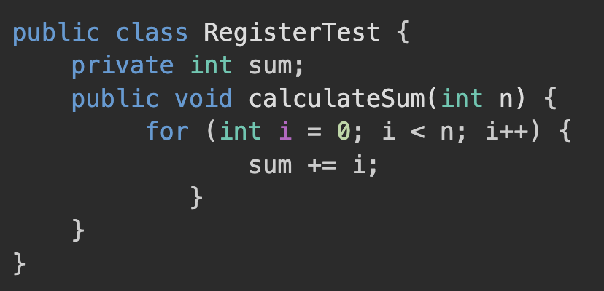
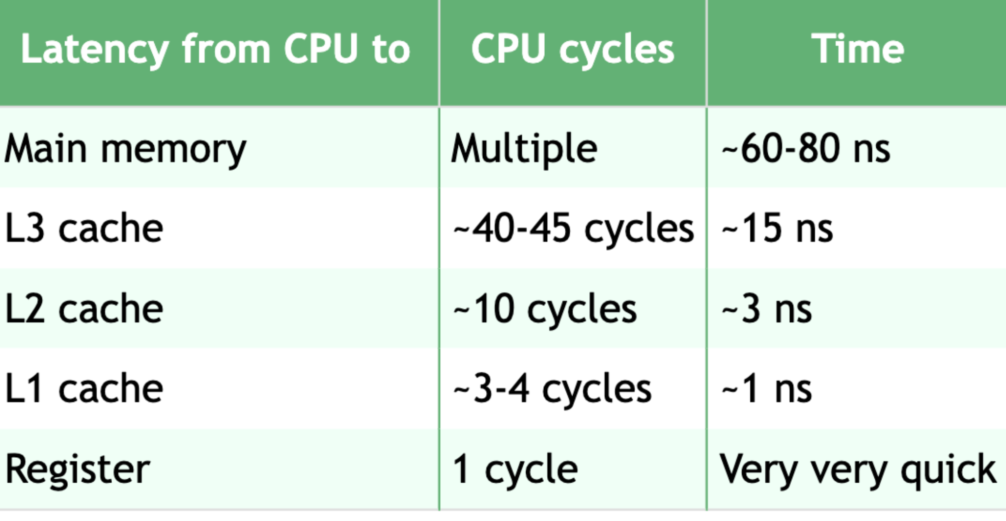
Registers and Main Memory
One of the most important optimizations a compiler can make involves when to use values from main memory and when to store values in a register. Consider this code:

Slide 20
Java’s Memory Model — Heap, Stack, and Metaspace
Heap
Non Heap
Eden
Survivor
Survivor
Old Generation
Metadata
Threads
Code
Cache
GC
Young Generation

Slide 21
Heap Memory Best Practices

Slide 22

Using Less Memory
The first approach to using memory more efficiently in Java is to use less heap memory. That statement should be unsurprising: using less memory means the heap will fill up less often, requiring fewer GC cycles. The effect can multiply: fewer collections of the young generation means the tenuring age of an object is increased less often meaning that the object is less likely to be promoted into the old generation.

Slide 23
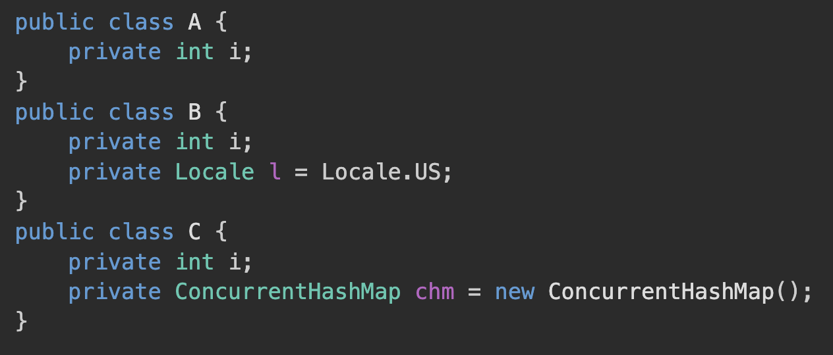
Reducing Object Size
Type | Size
byte | 1
char | 2
short | 2
int | 4
float | 4
long | 8
double | 8
reference | 8
The size of an object can be decreased by (obviously) reducing the number of instance variables it holds and (less obviously) by reducing the size of those variables.

Slide 24
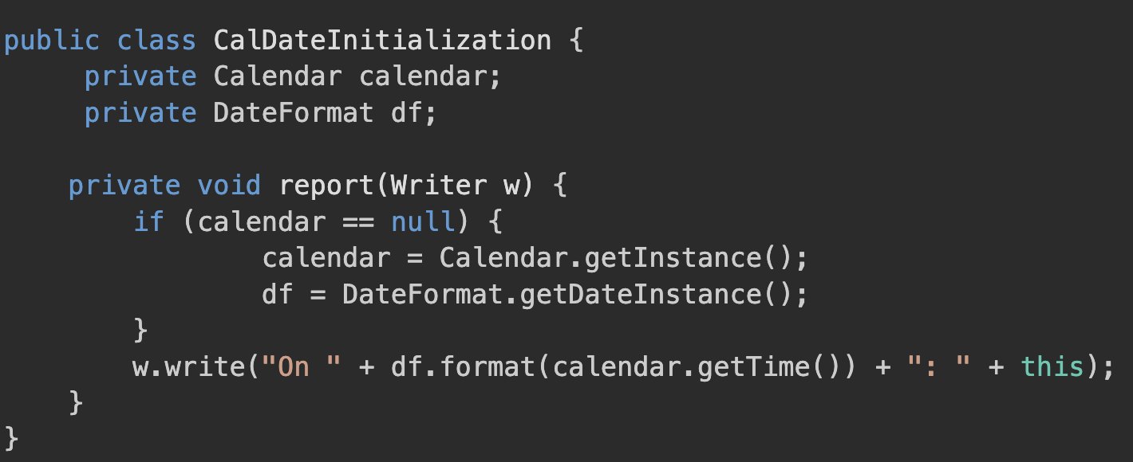
Using Lazy Initialization

Slide 25
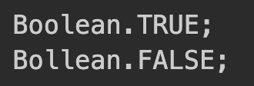
Using Immutable
In Java, many object types are immutable. This includes objects that have a corresponding primitive type—Integer, Double, Boolean, and so on—as well as other numeric-based types, like BigDecimal. The most common Java object, of course, is the immutable String. From a program design perspective, it is often a good idea for custom classes to represent immutable objects as well.
These singular representations of immutable objects are known as the canonical version of the object.

Slide 26
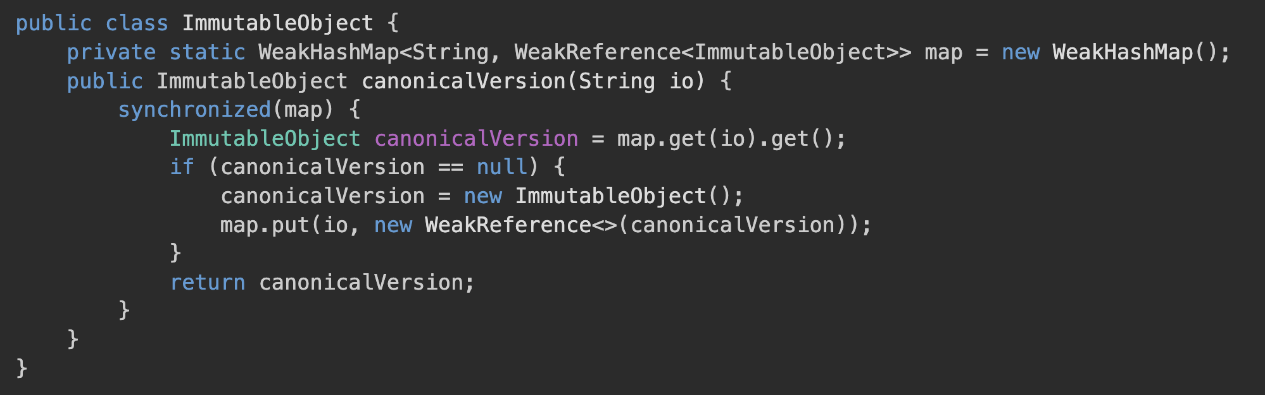
Canonical Objects

Slide 27
Object Reuse
Object reuse is commonly achieved in two ways: object pools and thread-local variables. Object pooling, in particular, is widely disliked in GC circles for that reason, though for that matter, object pools are also widely disliked in development circles for many other reasons.

Slide 28
Object Pools - Code

Slide 29
Thread Local - Code

Slide 30
Singleton design pattern - Code

Slide 31
Flyweight
Flyweight is a structural design pattern that allows programs to support vast quantities of objects by keeping their memory consumption low. The pattern achieves it by sharing parts of object state between multiple objects. In other words, the Flyweight saves RAM by caching the same data used by different objects.

Slide 32
Using primitive type collections
There is a couple of libraries providing the collections where primities could be stored instead of wrappers
https://github.com/real-logic/agrona
https://github.com/eclipse/eclipse-collections

Slide 33
Using primitive type collections
There is a couple of libraries providing the collections where primities could be stored instead of wrappers
https://github.com/real-logic/agrona
https://github.com/eclipse/eclipse-collections

Slide 34
Thread Synchronization

Slide 35
Costs of Synchronization
Synchronized areas of code affect performance in two ways. First, the amount of time an application spends in a synchronized block affects the scalability of an application. Second, obtaining the synchronization lock requires CPU cycles and hence affects performance.
Context Switching
Contention
Lock Acquisition and Release
Memory Consistency Effects

Slide 36
Avoiding Synchronization
If synchronization can be avoided altogether, locking penalties will not affect the application’s performance. Two general approaches can be used to achieve that.
Thread-local variable
CAS-based alternatives

Slide 37
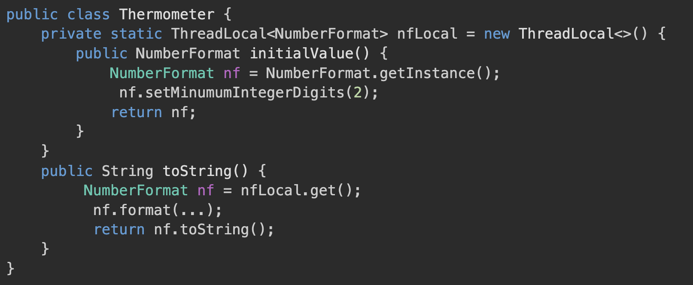
Thread-local variable

Slide 38
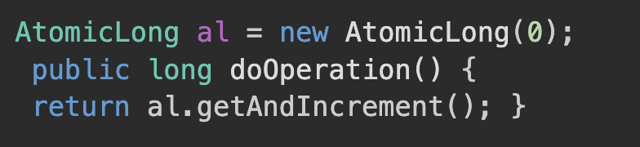
CAS-based alternatives

Slide 39
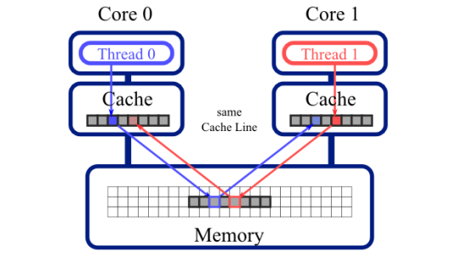
False sharing
Synchronized areas of code affect performance in two ways. First, the amount of time an application spends in a synchronized block affects the scalability of an application. Second, obtaining the synchronization lock requires CPU cycles and hence affects performance.

Slide 40
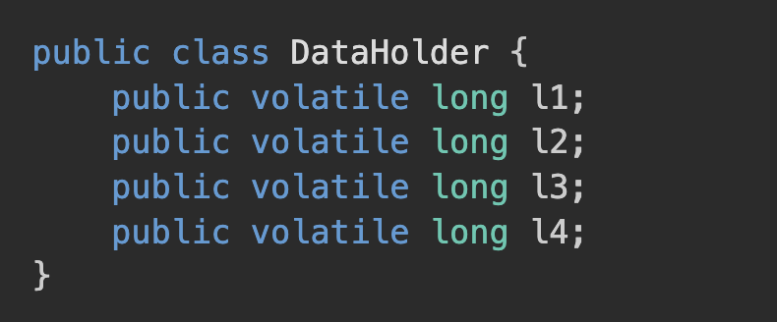
False sharing
Synchronized areas of code affect performance in two ways. First, the amount of time an application spends in a synchronized block affects the scalability of an application. Second, obtaining the synchronization lock requires CPU cycles and hence affects performance.

Slide 41
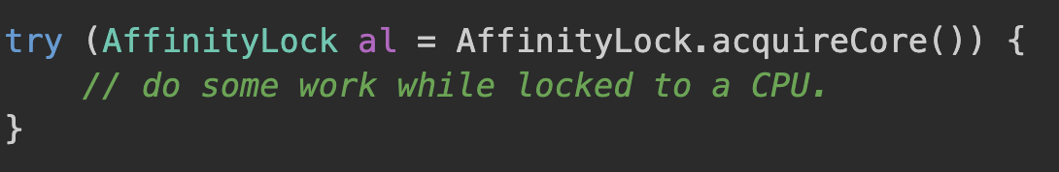
Thread Affinity
Thread affinity is the concept of mapping a thread to a specific processor or core in a multi-core system. When a thread is bound to a specific processor or core, it can only be executed on that processor or core. This can help to reduce cache misses, increase data locality, and reduce context switching overhead.

Slide 42
LMAX distruptor

Slide 43
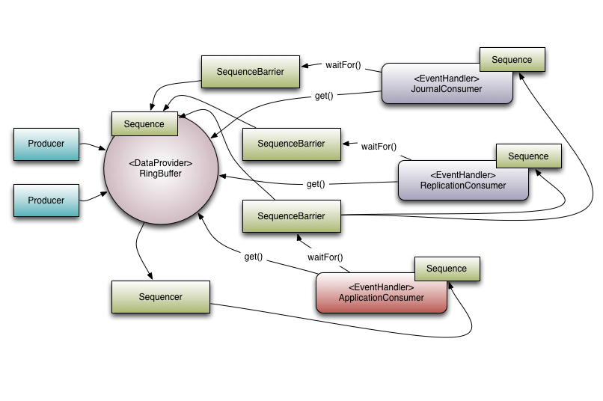
LMAX Disruptor
The LMAX Disruptor is a high performance inter-thread messaging library. It grew out of LMAX’s research into concurrency, performance and non-blocking algorithms and today forms a core part of their Exchange’s infrastructure.

Slide 44
LMAX Disruptor
To understand the benefits of the Disruptor we can compare it to something well understood and quite similar in purpose. In the case of the Disruptor this would be Java’s BlockingQueue. Like a queue the purpose of the Disruptor is to move data (e.g. messages or events) between threads within the same process. However, there are some key features that the Disruptor provides that distinguish it from a queue. They are:
Multicast events to consumers, with consumer dependency graph.
Pre-allocate memory for events.
Optionally lock-free.

Slide 45
Ring Buffer
The ring buffer is a circular software queue. This queue has a first-in-first-out (FIFO) data characteristic. These buffers are quite common and are found in many embedded systems. Usually, most developers write these constructs from scratch on an as-needed basis.

Slide 46
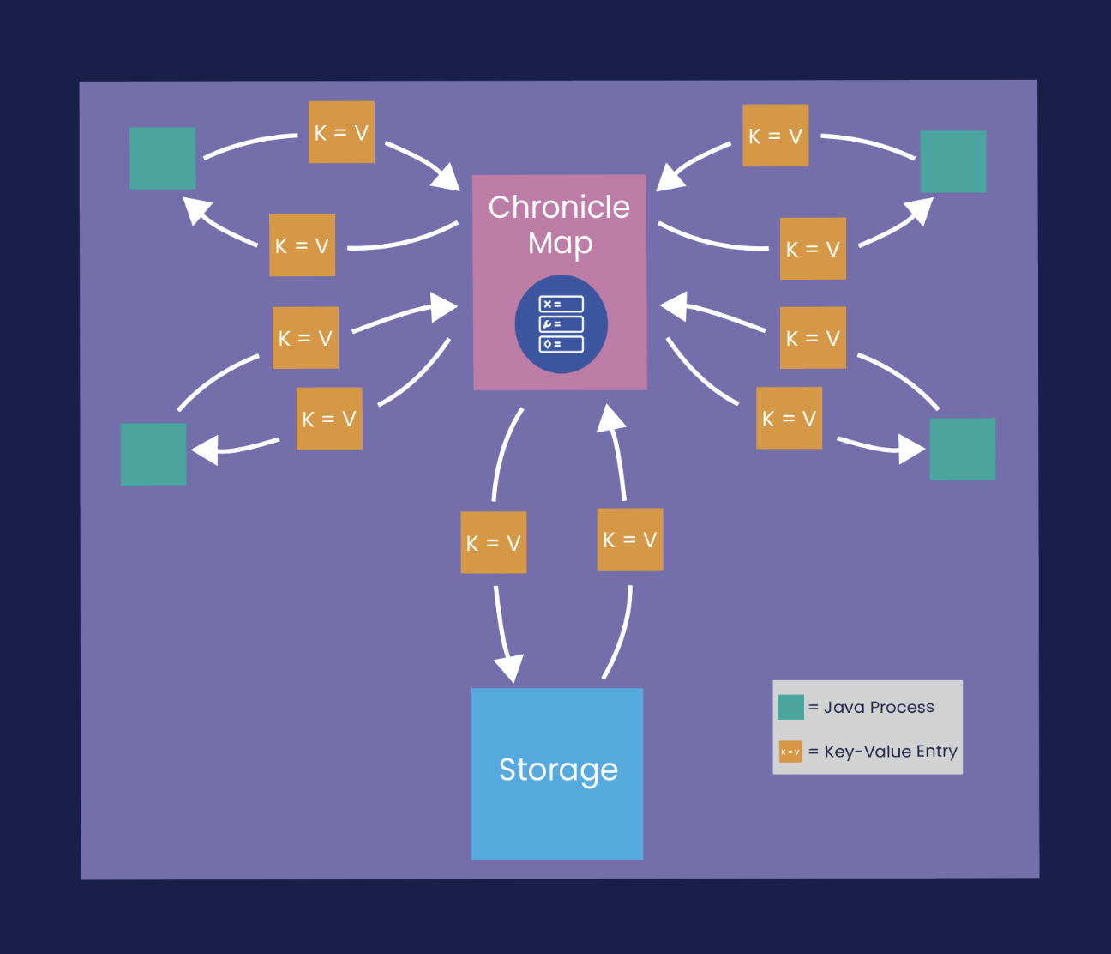
Chronicle Map
Chronicle Map is a super-fast, in-memory, non-blocking, key-value store, designed for low-latency, and/or multi-process applications such as trading and financial market applications. See Features doc for more information.
The size of a Chronicle Map is not limited by memory (RAM), but rather by the available disk capacity.

Slide 47
Chronicle Map
Use cases:
Real-time trading systems
highly concurrent systems

Slide 48
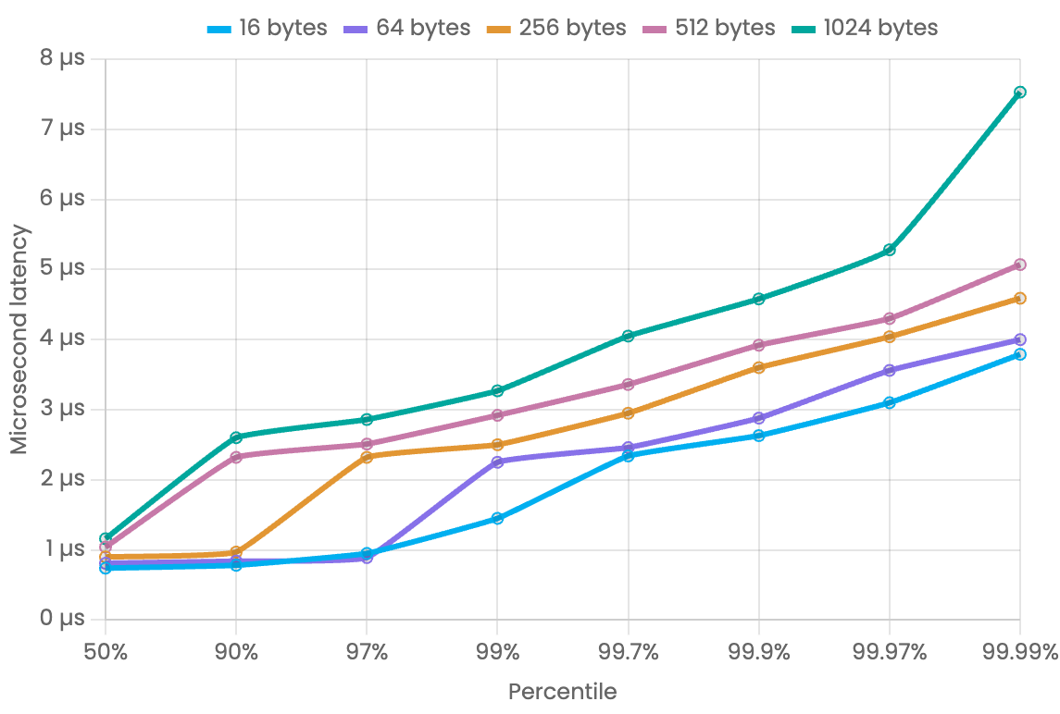
Chronicle Queue
Chronicle Queue can be considered to be similar to a low-latency, broker-less durable/persisted JVM topic. It is a distributed, unbounded, persisted queue that:
Supports asynchronous RMI and pub/sub interfaces with microsecond latencies
Passes messages between JVMs in under 1 µs*
Provides stable, soft, real-time latencies into the millions of messages/s for a single thread to one queue

Slide 49

Is Java a good choice for low latency programing ?

Slide 50
Resources:
https://www.oreilly.com/library/view/java-performance-2nd/9781492056102/
https://chronicle.software/chronicle-tune-your-cpu/
https://chronicle.software/chronicle-tune-your-cpu/
https://chronicle.software/java-is-very-fast/
https://blog.stackademic.com/optimizing-java-for-low-latency-applications-803e181d0add
https://www.youtube.com/watch?v=36t5OLLzA6c
https://www.youtube.com/watch?v=BD9cRbxWQx8

